Slide 1

UNIT II
REGULAR EXPRESSIONS AND REGULAR SETS

Slide 2
UNIT II SYLLABUS
REGULAR EXPRESSIONS AND REGULAR SETS : Regular Expressions and Identities for Regular Expressions, Finite Automata and Regular Expressions: Transition System Containing null moves, NDFA with null moves and Regular Expressions, Conversion of Non-deterministic Systems to Deterministic Systems, Algebraic Methods using Arden's Theorem, Construction of Finite Automata Equivalent to a Regular Expression, Equivalence of Two Finite Automata and Two Regular Expressions, Closure Properties of Regular Sets, Pumping Lemma for Regular Sets and its Application, Equivalence between regular languages: Construction of Finite Automata Equivalent to a Regular Expression, Properties of Regular Languages, Non-deterministic Finite Automata with Null Moves and Regular Expressions, Myhill-Nerode Theorem

Slide 3
REGULAR EXPRESSIONS
The language accepted by finite automata can be easily described by simple expressions called Regular Expressions. It is the most effective way to represent any language.
The languages accepted by some regular expression are referred to as Regular languages.
A regular expression can also be described as a sequence of pattern that defines a string.
Regular expressions are used to match character combinations in strings. String searching algorithm used this pattern to find the operations on a string.

Slide 4
In a regular expression, x* means zero or more occurrence of x.
  It can generate {e, x, xx, xxx, xxxx, .....}
In a regular expression, x⁺ means one or more occurrence of x.
  It can generate {x, xx, xxx, xxxx, .....}

Slide 5
REGULAR EXPRESSIONS
A Regular Expression can be recursively defined as follows −
ε is a Regular Expression indicates the language containing an empty string. (L (ε) = {ε})
φ is a Regular Expression denoting an empty language. (L (φ) = { })
x is a Regular Expression where L = {x}

Slide 6
OPERATIONS ON REGULAR LANGUAGE
Union: If L and M are two regular languages then their union L U M is also a union.
L U M = {s | s is in L or s is in M}
Intersection: If L and M are two regular languages then their intersection is also an intersection.
L ⋂ M = {st | s is in L and t is in M}
Kleen closure: If L is a regular language then its Kleen closure L1* will also be a regular language.
L* = Zero or more occurrence of language L.

Slide 7
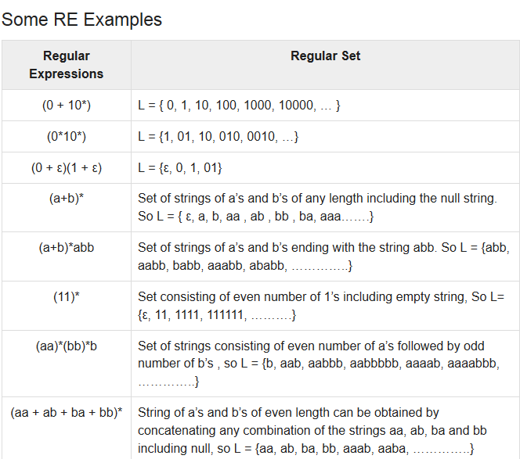

Slide 8
REGULAR SETS
Any set that represents the value of the Regular Expression is called a Regular Set.
Properties of Regular Sets
Property 1: The union of two regular set is regular.
Property 2:The intersection of two regular set is regular.
Property 3: The complement of a regular set is regular.
Property 4: The difference of two regular set is regular.
Property 5:The reversal of a regular set is regular.
Property 6:The closure of a regular set is regular.
Property 7: The concatenation of two regular sets is regular.

Slide 9
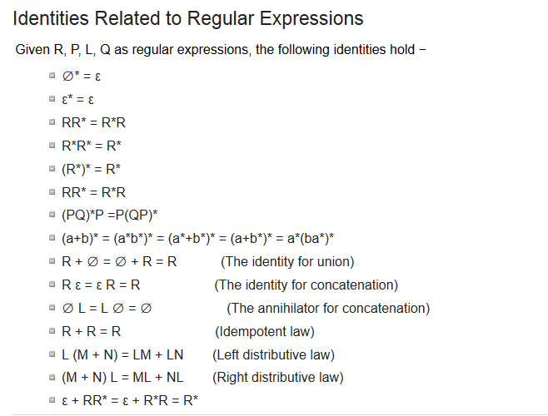

Slide 10
EXAMPLES OF REGULAR EXPRESSION
Write the regular expression for the language accepting all the string containing any number of a's and b's.

Slide 11
2. Write the regular expression for the language accepting all combinations of a's, over the set ∑ = {a}.

Slide 12
3. Write the regular expression for the language accepting all combinations of a's except the null string, over the set ∑ = {a}.

Slide 13
4. Write the regular expression for the language accepting all the string which are starting with 1 and ending with 0, over ∑ = {0, 1}.

Slide 14
5. Write the regular expression for the language starting with a but not having consecutive b's.

Slide 15
6. Write the regular expression for the language starting and ending with a and having any combination of b's in between.

Slide 16
7. Write the regular expression for the language accepting all the string in which any number of a's is followed by any number of b's is followed by any number of c's.

Slide 17
8. Write the regular expression for the language over ∑ = {0} having even length of the string.

Slide 18
9. Write the regular expression for the language L over ∑ ={0,1} such that all the string do not contain the substring 01.

Slide 19
POLLING QUESTIONS
1. Regular expression for all strings starts with ab and ends with bba is:
A) aba*b*bba
B) ab(ab)*bba
C) ab(a+b)*bba
D) All of the mentioned
Notes:
C

Slide 20
Conversion of RE to FA
To convert the RE to FA, we are going to use a method called the subset method. This method is used to obtain FA from the given regular expression. This method is given below:
Step 1: Design a transition diagram for given regular expression, using NFA with ε moves.
Step 2: Convert this NFA with ε to NFA without ε.
Step 3: Convert the obtained NFA to equivalent DFA.

Slide 21
Examples
Design a FA from given regular expression
10 + (0 + 11)0* 1
2. Design a NFA from given regular expression 1 (1* 01* 01*)*

Slide 22
CONVERSION OF FA TO RE
ARDEN’S THEOREM
The Arden's Theorem is useful for checking the equivalence of two regular expressions as well as in the conversion of DFA to a regular expression.

Slide 23
ALGORITHM
Arden’s theorem state that:
“If P and Q are two regular expressions over ∑, and if P does not contain epsilon, then the following equation in R given by R = Q + RP has an unique solution i.e., R = QP*.”
That means, whenever we get any equation in the form of R = Q + RP, then we can directly replaced by R = QP*.

Slide 24
PUMPING LEMMA FOR REGULAR EXPRESSIONS
Theorem
Let L be a regular language. Then there exists a constant ‘c’ such that for every string w in L −
|w| ≥ c
We can break w into three strings, w = xyz, such that −
|y| >=1
|xy| ≤ c
For all k ≥ 0, the string xy^{k}z is also in L.

Slide 25
Applications of Pumping Lemma
Pumping Lemma is to be applied to show that certain languages are not regular. It should never be used to show a language is regular.
If L is regular, it satisfies Pumping Lemma.
If L does not satisfy Pumping Lemma, it is non-regular.

Slide 26
Method to prove that a language L is not regular
At first, we have to assume that L is regular.
So, the pumping lemma should hold for L.
Use the pumping lemma to obtain a contradiction −
  Select w such that |w| ≥ c
  Select y such that |y| ≥ 1
  Select x such that |xy| ≤ c
  Assign the remaining string to z.
  Select k such that the resulting string is not in L.
Hence L is not regular.

Slide 27
Thus, if a language is regular, it always satisfies pumping lemma.
If there exists at least one string made from pumping which is not in L, then L is surely not regular.

Slide 28
Practice Question
1. Prove L₀₁ = {a^{n}b^{n} | n ≥ 1} is irregular.

Slide 29
POLLING QUESTIONS
1. While applying Pumping lemma over a language, we consider a string w that belong to L and fragment it into _________ parts.
a) 2
b) 5
c) 3
d) 6
Notes:
c

Slide 30
2. If we select a string w such that w∈L, and w=xyz. Which of the following portions cannot be an empty string?
a) x
b) y
c) z
d) all of the mentioned
Notes:
b

Slide 31
3. Answer in accordance to the third and last statement in pumping lemma:
For all _______ xy^{i}z ∈L
a) i>0
b) i<0
c) i<=0
d) i>=0
Notes:
d

